Slide 1
Malaysian Mathematics Teacher Quality standards
Prepared by
Thien Lei Mee, Ph.D.
Research & Development Division
SEAMEO RECSAM, Penang
leimee@recsam.edu.my

Slide 2
Malaysian Teacher Standards (MTS):
3 domains stated in MTS:
Professional values within the teaching profession;
knowledge of understanding of education, subject matter, curriculum & co-curriculum;
Skills of teaching and learning

Slide 3
International Large Scale Assessment
Mathematic literacy
OECD average: 494
Mean score:421

Slide 4
Rationale
Malaysian students’ performance in TIMSS 2011 and PISA 2012 have accelerated the momentum to develop the Malaysian mathematics teacher quality standards that serves as a guidance which in turn, informs pedagogical and local educational policy making.
Malaysian Teacher Standards is not specific to Mathematic subject!

Slide 5
Basic of Development –Southeast Asia Regional Standards-Mathematics Teachers (SEARS-MT)

Slide 6
Purposes
As a guide to provide benchmarks for relevant Malaysian educational divisions in formulating policies to improve and enhance the quality of mathematics teachers,
As a guide in structuring teacher education programmes in in-service mathematics teacher preparation
As a guide for teacher professional development at personal level and performance evaluation at school level

Slide 7
Methodology
Collaborative inquiry approach
Workshop: 12-13 June 2014, SEAMEO RECSAM, Penang, Malaysia
Consultants and Participants:
25 educators from foreign and local universities, officers from Malaysian Ministry of Education, teacher training institutions, researchers, school teachers

Slide 8
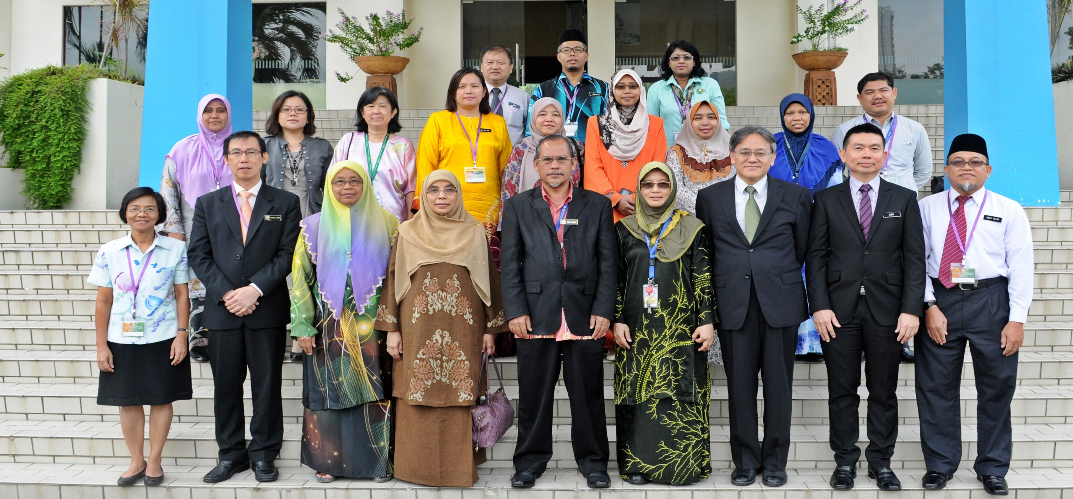
Workshop: 12-13 June 2014, SEAMEO RECSAM

Slide 9
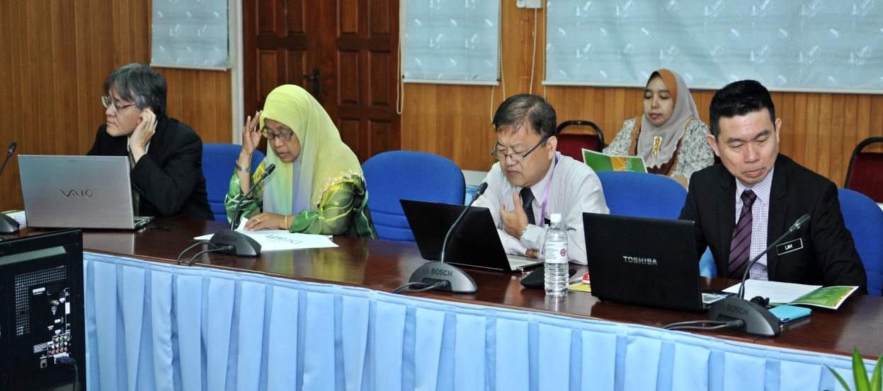
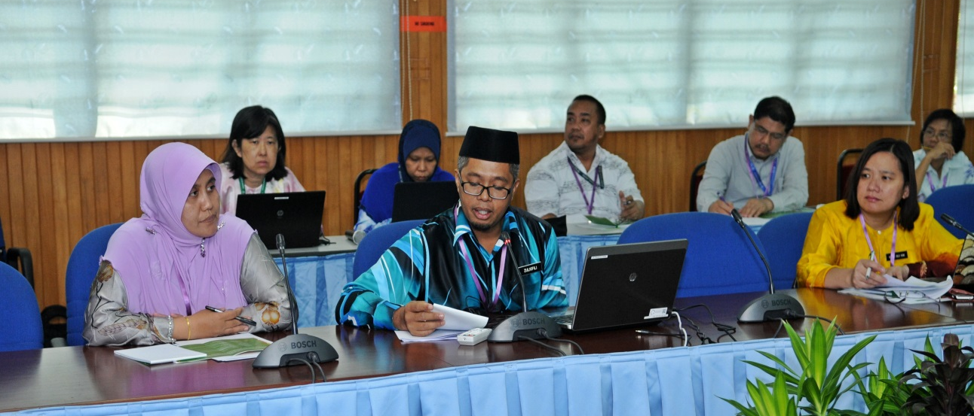
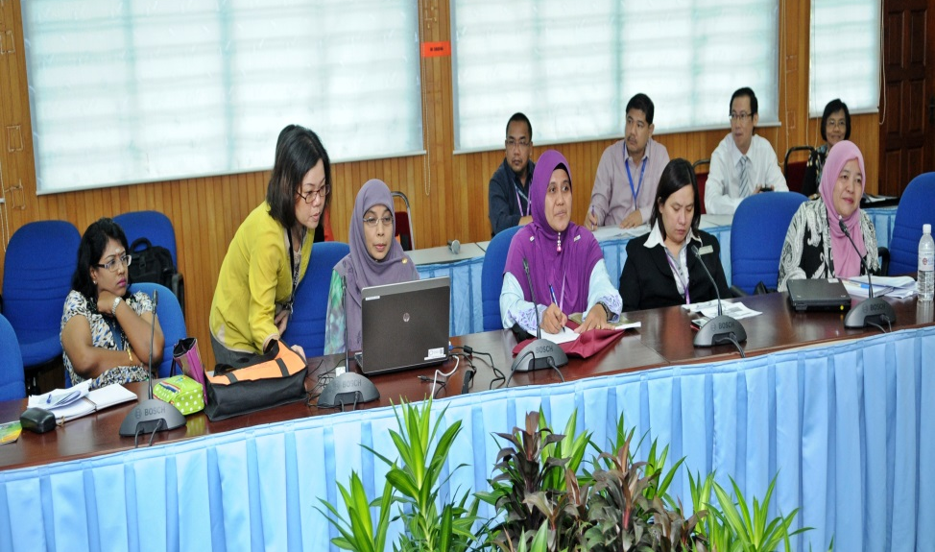
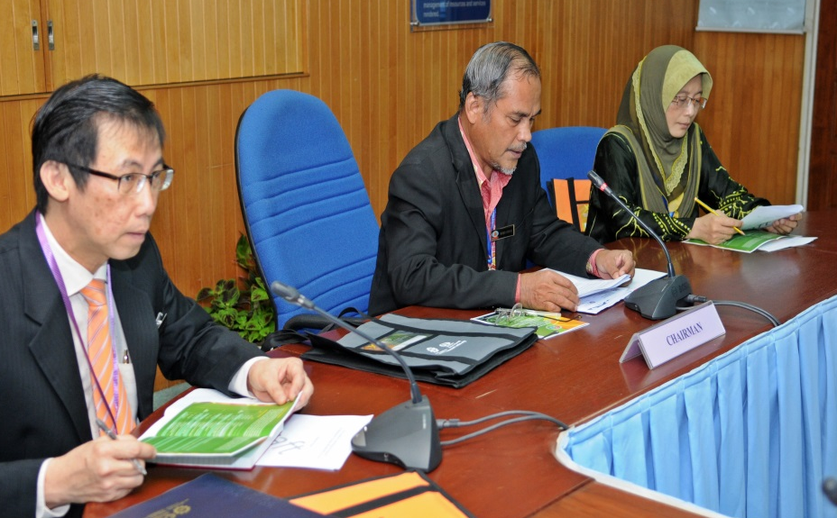
Workshop: 12-13 June 2014, SEAMEO RECSAM, Penang

Slide 10
Components
Dimensions:
(1) Professional knowledge,
(2) Professional teaching and learning process,
(3) Personal and professional attributes, &
(4) Professional communities
*4 dimensions are not mutually exclusive
Standards
Indicators
71 local descriptors

Slide 11
Dimension 1: Professional Knowledge
Standard 1: Knowledge of Mathematics
Indicator 1: Knowledge of the discipline of mathematics
Local descriptors (5)
LD1: Understanding the nature and scope of mathematical content expected to be taught throughout the curriculum
LD2: Understanding a body of mathematical knowledge that is relevant to teaching and consistent with the fundamental principles of mathematics
LD3: Ability to explain the fundamentals principles of mathematics in terms of precision, definitions, reasoning, coherence and purposefully
LD4: Understanding of subject matter concepts and how these concepts related to form larger body of knowledge
LD5: Understanding of mathematics content expected to be taught at a particular level

Slide 12
Dimension 2: Professional Teaching
Standard 3: Implementing teaching strategies
Indicator 1:Use of effective communication
3 local descriptors (LD):
LD1: Employ a variety of effective discussions (pair, group and whole class) maximising the opportunities for students meaningful learning and interest in mathematics
LD2: Utilise mathematically effective communication either verbally or in written form
LD3: Encourage communications that promote justification and reasoning in the learning of mathematics

Slide 13
Dimension 3: Personal and Professional Attributes
Standard 2: Personal professional development
Indicator 1: Commit to lifelong learning and personal development
1 local descriptor (LD):
LD1: Continuously enrich and upgrade knowledge and skills pertaining to mathematics and mathematics teaching

Slide 14
Dimension 4: Professional Communities
Standard 2: Professional Communities at schools
Indicator 2: Participate in the school-based professional learning community (e.g., mentoring, lesson study)
3 local descriptors:
LD1: Participate in school based staff development programs
LD2: Volunteer to participate in school based research groups
LD3: Sharing best practices in teaching mathematics

Slide 15
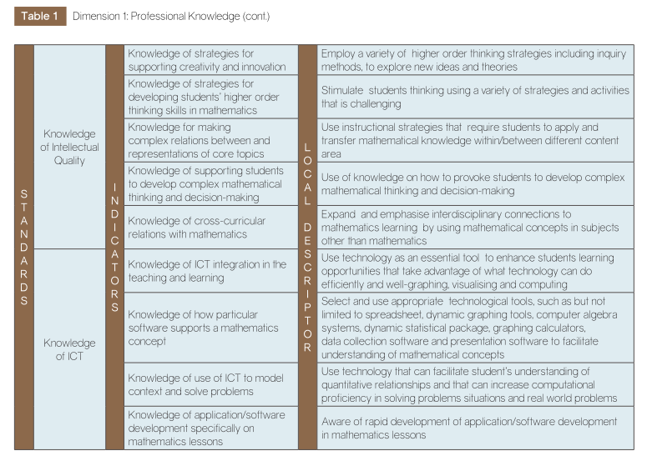
Please refers to the booklet for other local descriptors details
Local Descriptors

Slide 16
Next step…
The current MMTQS could be further revised and improved by getting more feedback in terms of its usability and practicality from the school administrators and teachers.

Slide 17
Potential Use:
As a nation initiative, the Malaysian Mathematics Teacher Quality Standards could be used as an inspirational guidance for the other developing countries in the Southeast Asia region which attempt to develop their own mathematics teachers’ quality standards and indicators;
As an evaluation tool for teacher professional development related-educational programme.

Slide 18
Limitation
Generally conceptualized without a clear cut among pre and in-service teachers, and types of schools (e.g., National primary school, National type primary school, National type Tamil school).

Slide 19
Highlights
General versus Specific
Mathematics teacher quality: Does cultural influences really matters?

